Slide 1
Literacy Motivation & Engagement
Essential Instructional Strategy #1
Slides taken from a presentation created by Nell Duke,
Presented at the Early Literacy Coach August Institute

Slide 2
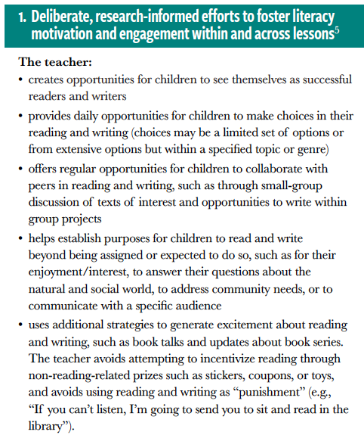

Slide 3
Standards are higher.
Competition is steeper.
Instruction needs to be more engaging.
Duke

Slide 4
Success
Tasks for which success is well defined.
I can . . . statements
Discussions
Anchor charts
Checklists
Rubrics
Duke

Slide 5
Success
Specific, frequent feedback related to markers of success. For example, for writing:
“I like the way you started that paragraph—it tells what the whole paragraph is about.”
“I like the way you’re using humor. It seems right for the audience.”
“I like all the precise vocabulary you’re using. It helps me ‘see’ what you’re saying.”
“I like the way you spelled that word—I can really see you were listening to the sounds in the word.”
Duke

Slide 6
From the Essentials . . .
The teacher:
• provides daily opportunities for children to make choices in their reading and writing (choices may be a limited set of options or from extensive options but within a specified topic or genre)

Slide 7
Choice (within limits)
What to listen to
What to read
What to write
How to respond
The order in which to complete tasks
Homework options
And so on
Duke

Slide 8
From the Essentials . . .
The teacher:
• offers regular opportunities for children to collaborate with peers in reading and writing, such as through small-group discussion of texts of interest and opportunities to write within group projects

Slide 9
Collaboration
Example structures for collaboration:
• Partner reading
Paired or small-group discussion
Group writing projects
Acting out stories together
Readers’ theater
Information share
Working together to follow a how-to text
Duke

Slide 10
From the Essentials . . .
The teacher:
• helps establish purposes for children to read and write beyond being assigned or expected to do so, such as for their enjoyment/interest, to answer their questions about the natural and social world, to address community needs, or to communicate with a specific audience

Slide 11
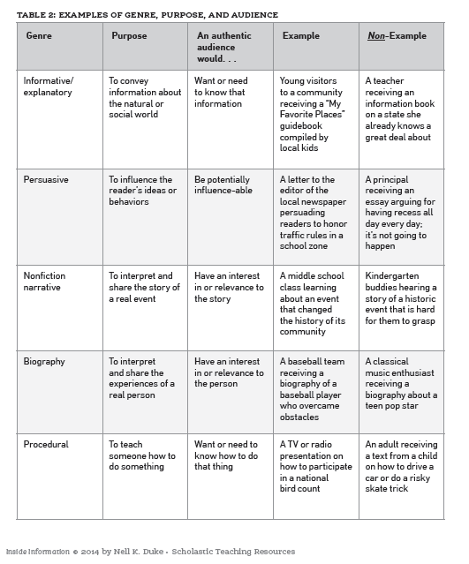

Slide 12
(Duke, 2014, pp. 40 – 41)

Slide 13
Generating Reading Interest
Closely related to Essential #8
Providing high-interest books
Tools that can help include:
interest inventories or interviews
just listening and observing
“Book blessings” (Marinak & Gambrell, 2016)
Book clubs
Motivational moments (i.e., teachable moments for motivation)
Projects
Duke

