Slide 1
Phonological Awareness
Essential Instructional Strategy #4
Slides taken from a presentation designed by Laura S. Tortorelli,
Presented at the Early Literacy Coach August Institute

Slide 2
Instructional Practice #4: Building Phonological Awareness
Teachers promote phonological awareness development, particularly phonemic awareness development, through explicit explanation, demonstration, play with sounds in words, and engaged study of words.

Slide 3
Phonological Awareness Development
Rhyme
dog, fog, bog, frog
Syllables
dog-house, dog-gy, splat-ter
Onset-rime
d-og, sh-ip, spl-at
Phonemes
d-o-g, s-p-l-a-t, sh-i-p, t-r-ea-t
Yopp & Yopp, 2000

Slide 4
Phonological Awareness Development
First sounds
cupcake, frog, ball
Last sounds
snowman, fall, bat
Middle sounds
hop, red, boat
Bear, Invernizzi, Templeton, & Johnson, 2015; Yopp & Yopp, 2000

Slide 5
Phonological Awareness Tasks
Matching
Isolation
Blending
Segmentation
Deletion/Substitution

Slide 6
Phonological Awareness Tasks
Matching
Which two words rhyme?
mat, flat, can
can, corn, man
Do these word start the same?
hammer, hamburger
Which two words start with the same sound?
fish, dish, fan
Do these words have the same vowel sound in the middle?
feet, beach

Slide 7
Phonological Awareness Tasks
Isolation
What sound do you hear at the beginning of bug?
What sound do you hear at the end of hat?

Slide 8
Phonological Awareness Tasks
Blending
What do you get if put these sounds together?
Cow-boy
Kit-ten
Sp-oon
F-a-n

Slide 9
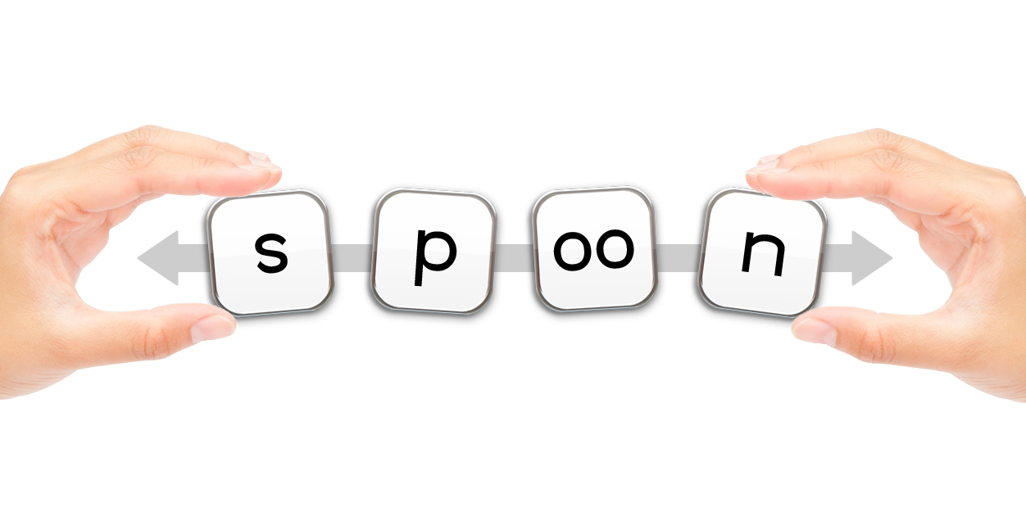
Phonological Awareness Tasks
Segmentation
Tell me the parts you hear in this word:
ta-ble
Tell me the sounds you hear in this word:
sp-oon
d-o-g

Slide 10
Phonological Awareness Tasks
Deletion/Substitution
What word would you have if said napkin without the kin?
What word would you have if you changed the box in sandbox to wich?
What word would you have if you said ball without the /b/?
What word would you have if you changed the /t/ in cat to /n/?

Slide 11
Things to Look Out For
Lessons or activities operating exclusively at the lower levels of phonological awareness (e.g., rhyme) and not including work at the phonemic level.
Lessons or activities that do not vary the difficulty of the phonological tasks (e.g., lessons that focus primarily on having children repeat words or match words).

Slide 12
Instructional Practice #4: Building Phonological Awareness
Teachers promote phonological awareness development, particularly phonemic awareness development, through explicit explanation, demonstration, play with sounds in words, and engaged study of words.

Slide 13
Explicit explanation
“Words rhyme when they sound the same at the end. Ball and call rhyme because they both end with all.”
Sun and sit both start with the same sound, the /s/ sound.
When we put the /s/, /u/, and /n/ sounds together, we get the word sun.

Slide 14
Demonstration
“Ball and call rhyme. I can think of other words that rhyme with ball and call: fall, mall, wall, tall.”
Sun and sit start with the /s/ sound. So do summer, Sammy, and seal!
/s/, /u/, /n/ makes sun! /h/, /a/, /t/ makes hat!
If I take the sound /b/ away from ball, I get all!

Slide 15
Play with sounds in words
Songs
Games
Riddles
Tongue Twisters
Books

Slide 16
Play with sounds in words
Songs
I like to ate, ate, ate aipples and banaynays!
Did you ever see a fly wearing a tie down by the bay? (“Down by the Bay”, Raffi)

Slide 17
Play with sounds in words
Poems
Furry Bear
If I were a bear, And a big bear too, I shouldn't much care If it froze or snew; I shouldn't much mind If it snowed or friz-- I'd be all fur-lined With a coat like his! For I'd have fur boots and a brown fur wrap, And brown fur knickers and a big fur cap. I'd have a fur muffle-ruff to cover my jaws. And brown fur mittens on my big brown paws. With a big brown furry-down up to my head, I'd sleep all the winter in a big fur bed. --A.A. Milne

Slide 18
Play with sounds in words
Games
I’m going camping, and I’m going to pack peanuts, paper, pencils, pistachios . . .
“I spy, with my little eye, something that starts with the /s/ sound”.

Slide 19
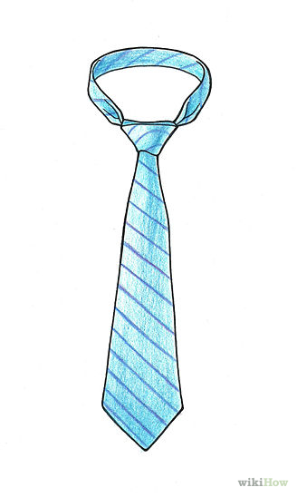
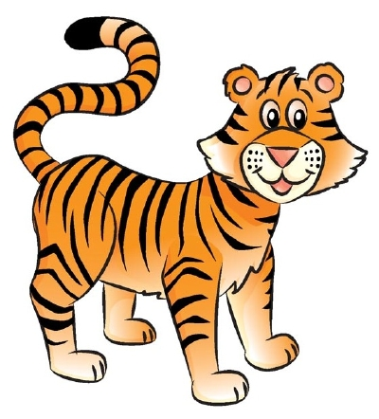
Play with sounds in words
Riddles
?

Slide 20
Engaged study of words
such as by:
listening to and creating variations on books and songs with rhyming or alliteration
sorting pictures, objects, and written words by a sound or sounds (e.g., words with a short e sound versus words with a long e sound)
activities that involve segmenting sounds in words (e.g., Elkonin boxes, in which children move a token or letters into boxes, with one box for each sound in the word)
activities that involve blending sounds in words (e.g., “robot talk” in which the teacher says the sounds “fffff ” “iiiii” “shhhh” and children say fish)
daily opportunities to write meaningful texts in which they listen for the sounds in words to estimate their spellings

Slide 21
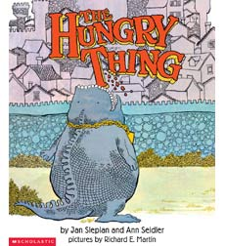
Engaged study of words
Listening to and creating variations on books and songs with rhyming or alliteration.
Ask children:
What else could the hungry thing want?
pamburgers
strizza
faghetti
What if a new hungry thing comes to town? He wants:
pozza
hat dads
sindwiches
What else might this new hungry thing want?
The hungry thing wants:
schmancakes
tickles
feetloaf
gollipops

Slide 22
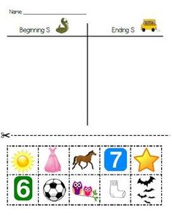
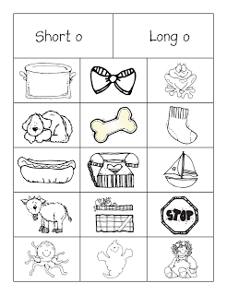
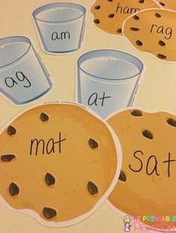
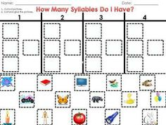
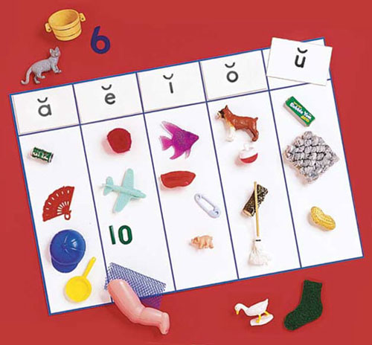
Engaged study of words
Sorting pictures, objects, and written words by a sound or sounds (e.g., words with a short e sound versus words with a long e sound).

Slide 23
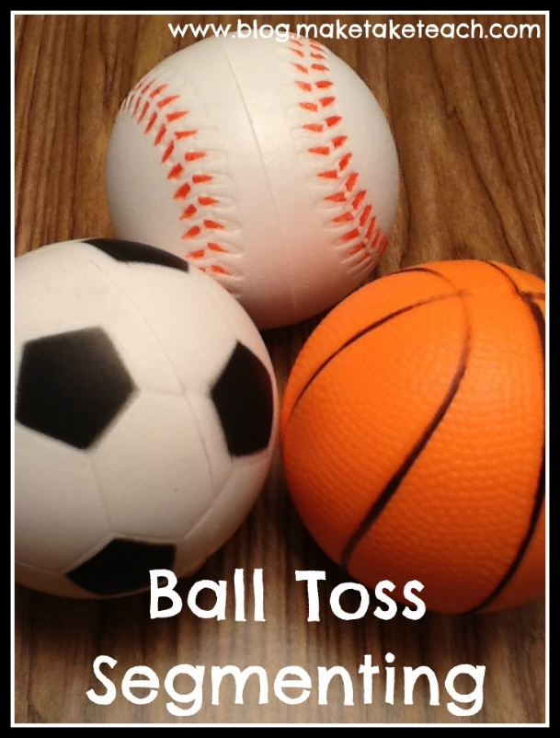
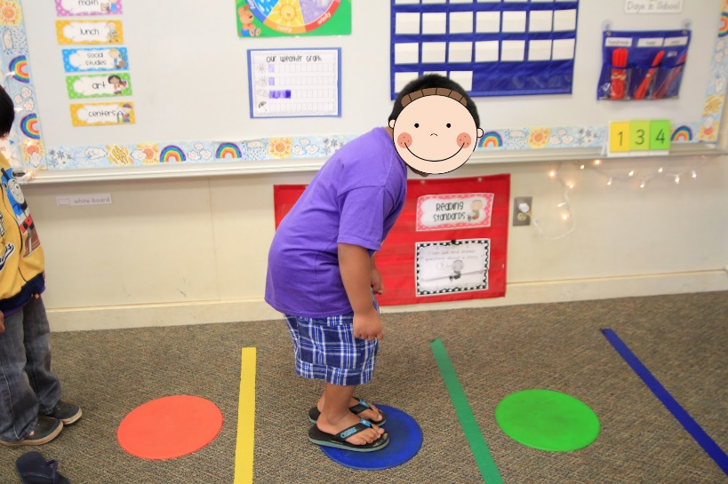
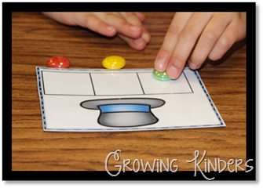
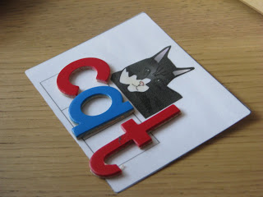
Engaged study of words
Activities that involve segmenting sounds in words (e.g., Elkonin boxes, in which children move a token or letters into boxes, with one box for each sound in the word).

Slide 24
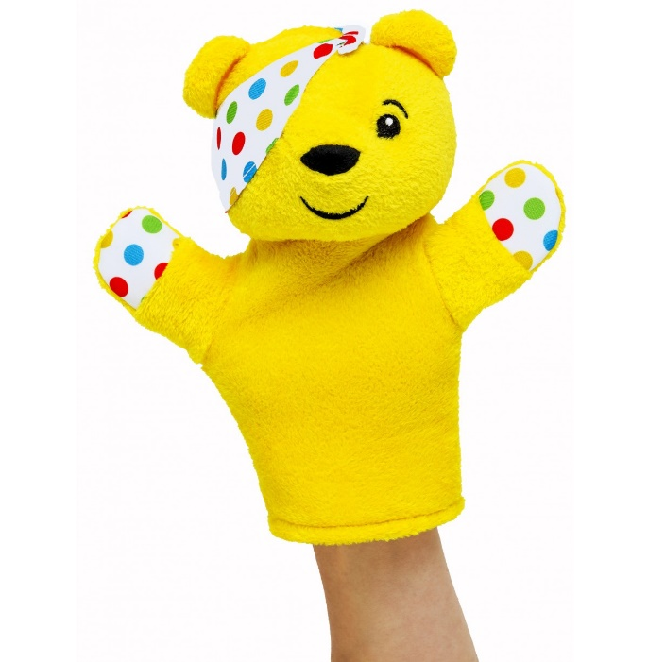
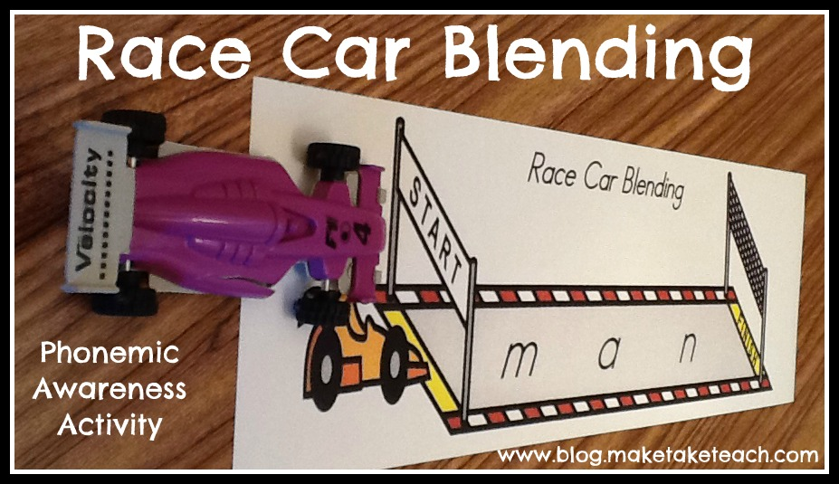
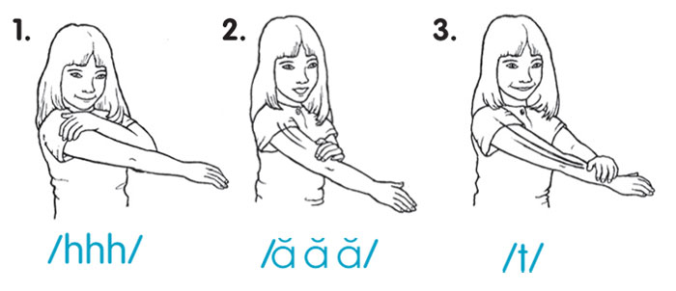
Engaged study of words
Activities that involve blending sounds in words (e.g., “robot talk” in which the teacher says the sounds “fffff ” “iiiii” “shhhh” and children say fish).

Slide 25
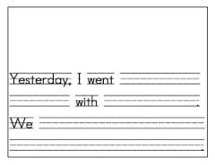
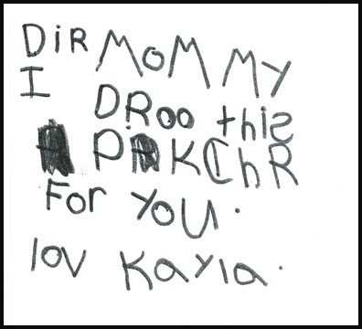
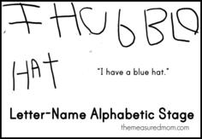
Engaged study of words
Daily opportunities to write meaningful texts in which they listen for the sounds in words to estimate their spellings.

Slide 26
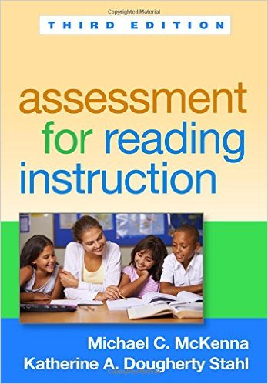
Recommended resource: Assessment for Reading Instruction, McKenna & Stahl

